Slide 1
CS325 Project #4.2
Studio Presentation
Team name : Early birds
Members: Cici, Foroogh, Michelle, Jaeseong
10/30/17

Slide 2

HLD - UI Mockup
Balsamiq
●5~7 pages.
Notes:
Balsamiq for UI Mockup which consists of 5 ~ 7 pages

Slide 3






HLD - Technologies
git
Bootstrap
React
Node.js, NPM, Atom
Notes:
VCS
Framework
Library
only for npm because we are focusing on VIEW part on the MVC pattern.

Slide 4
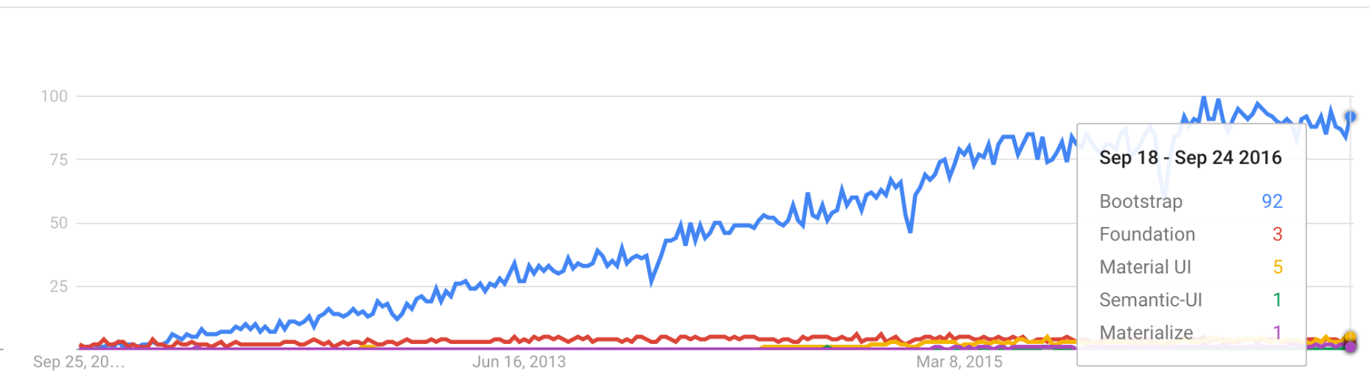
HLD - Technologies(Presentation Layer)
Bootstrap:
●Free open-source front-end web framework
●Easily create a modern interface
●Has many features built in, e.g. resizing web pages for screen size
Notes:
Strong
Easy to implement
Responsive web design

Slide 5
HLD - Technologies(Presentation Layer)
React :
●A javascript library for building UI
●React is divided into component objects
●Components are arranged in a tree-like relationship
●React: Virtual DOM - > Faster to render
Notes:
Scalability,
maintain.
reuse.

Slide 6
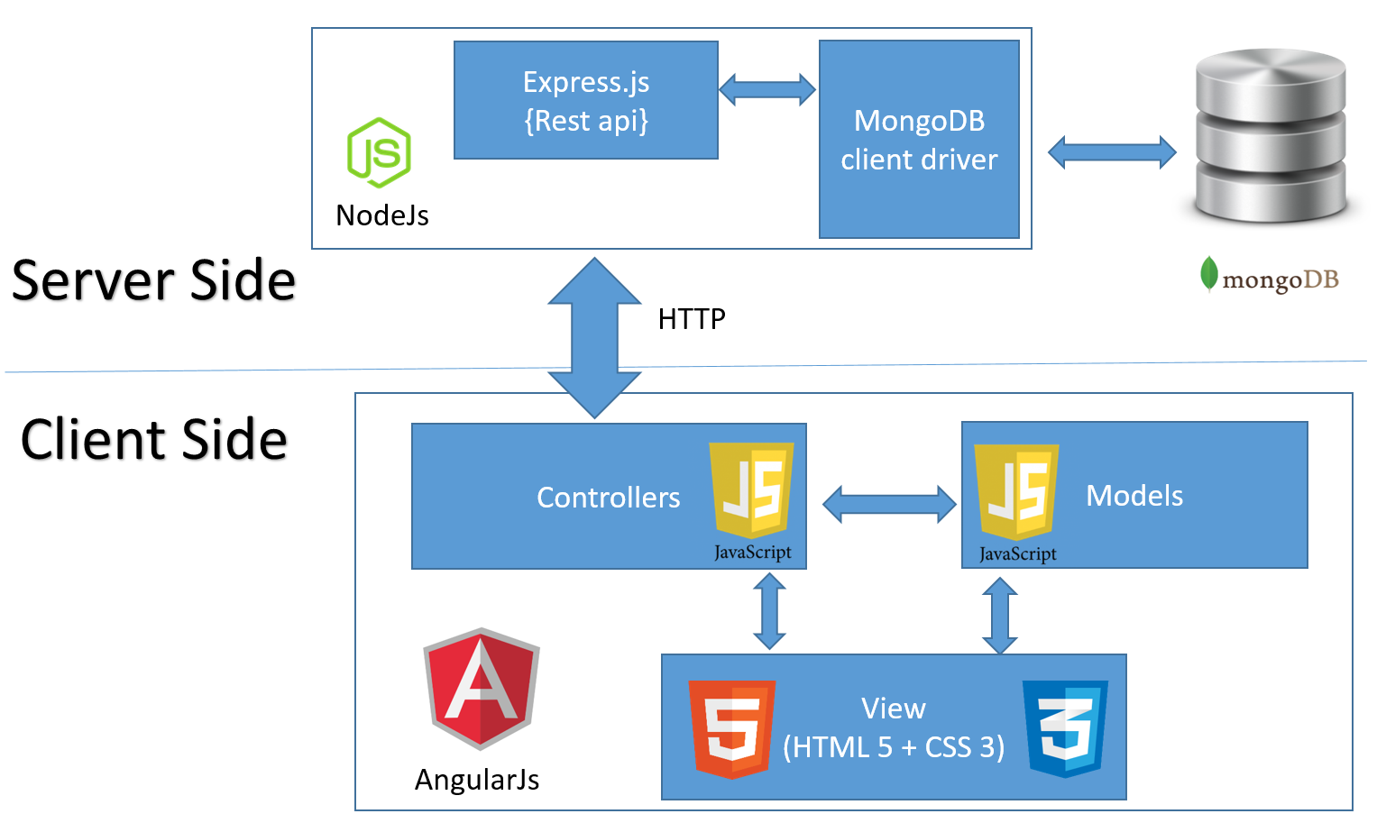
HLD - Technologies(Service Layer)
Node.js
●Cross-platform JavaScript runtime environment
●Same language as Bootstrap
●Lightweight, Easy to learn
●Asynchronous events
Notes:
npm because we are focusing on VIEW part on the MVC pattern.
Atom for text editor

Slide 7




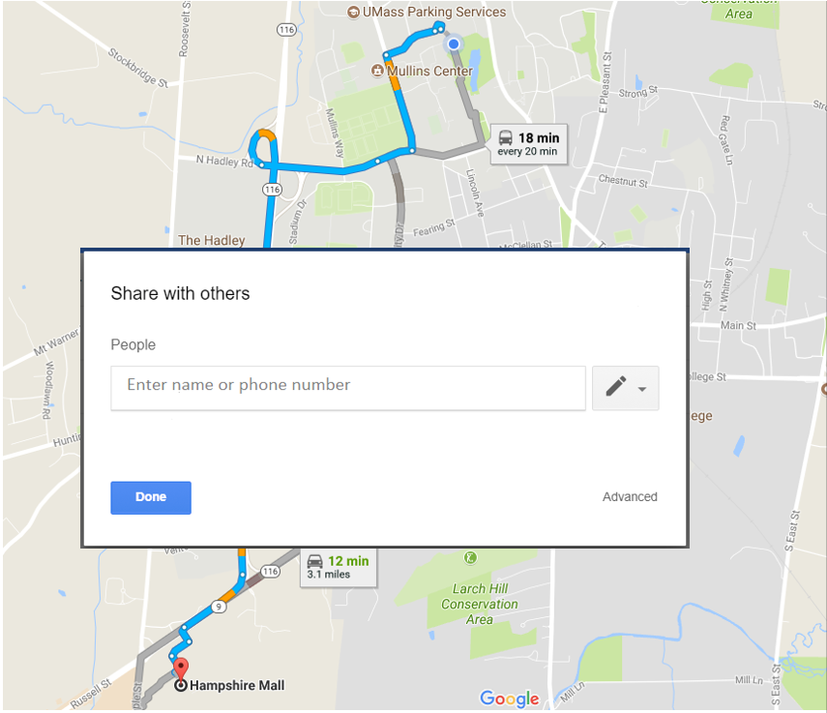
Application Features
Scheduled or random one-time trip
Individual accounts
List of riders drivers
Profile rating
Filtering feature
Sharing location and itinerary with family/friends
Payment Platforms
Notes:
Connects users with similar travel routes within a similar date/time window
The application can be used for scheduled or random one-time trips. Users can find members that have similar origin destination through a search engine. A rating feature for the app can be potentially added to improve the overall individual experience and level of trust with the application. Users can also share their location and their planned carpool trip before the trip with their friends or families through social media.
The payment among the parties involved in the carpool trip can either be done in person or through venmo based on the agreements of the parties using the application.
This application is intended to improve coordination between students (passengers and drivers), and provide a safe and convenient ride sharing experience.

Slide 8
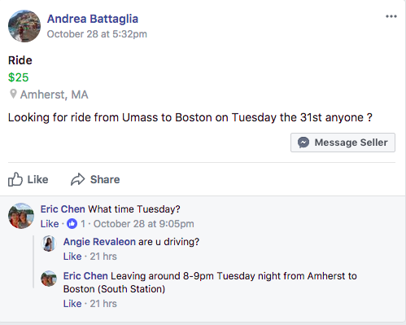
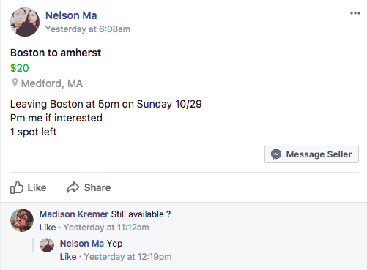
Expected Contribution
Distinction from UMass Facebook Rideshare Group
Live updates
Organized entries
Notes:
Accomplishing what UMass Facebook Rideshare Group doesn’t
Live updates (
-lots of comments asking how many spots left in a ride, services availability status w/ date/time of departure
-automatic counter of remaining seats when users sign up for a ride w/o having to dm OP; service availability required and explicit ← reduce lingering, save time
Organized entries
-(fb: scroll down to find what you need - no organization whatsoever)
- organize entries (or filter) by offers vs request, destinations, date/time of departure) ← easier navigation
Reduce anxiety, stress, time

Slide 9
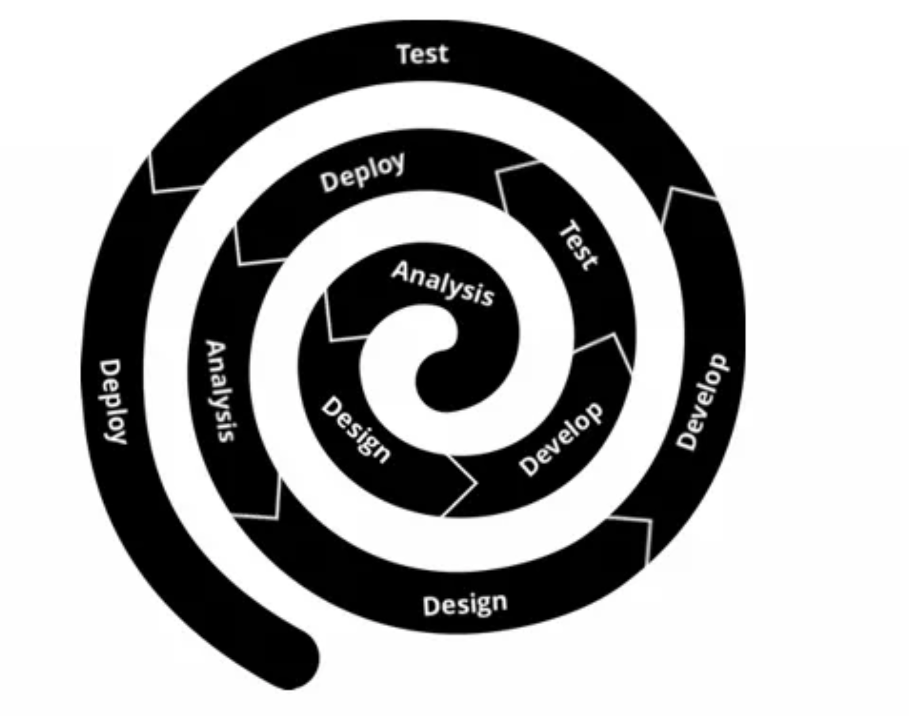
Current State & Next Step
Make a list of features that we think would be useful for users.
Interview target users and get to know their perspectives.
When was the last you traveled? What transportation you used?
Have you ever used any rideshare platform? What was your best/worst experience?
Is there any features you wish the Facebook Rideshare Group should have?
Fix the list of features & change the design plan.
Notes:
Using the spiral model of development to figure out what exactly users wants. We started with making a list of features that we think would be useful for users last week. Now we are in the process of interviewing our target users, by knowing their perspectives of features we listed before would be helpful for us to prevent the impact of groupthink. Our next step would be fix the list of features and the design plan based the responses we got from interviewees.

